Slide 1
Experiences with using
R in credit risk
Hong Ooi

Slide 2
Introduction
Not very sexy....
LGD haircut modelling
Through-the-cycle calibration
Stress testing simulation app
SAS and R
Closing comments

Slide 3
Mortgage haircut model
When a mortgage defaults, the bank can take possession of the property and sell it to recoup the loss¹
We have some idea of the market value of the property
Actual sale price tends to be lower on average than the market value (the haircut)²
If sale price > exposure at default, we don’t make a loss (excess is passed on to customer); otherwise, we make a loss
Expected loss = P(default) x EAD x P(possess) x exp.shortfall
Notes:
For ANZ, <10% of defaults actually result in possession
Meaning of “haircut” depends on context; very different when talking about, say, US mortgages

Slide 4
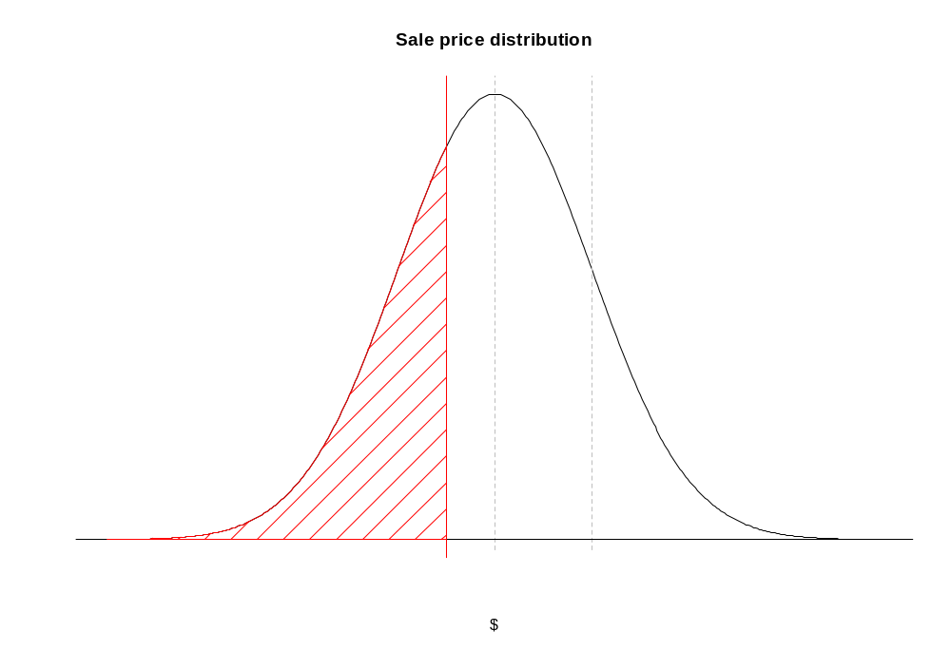
Valuation
Expected shortfall
Haircut
Exposure at default

Slide 5
Stat modelling
Modelling part is in finding parameters for the sale price distribution
  Assumed distributional shape, eg Gaussian
  Mean haircut relates average sale price to valuation
  Spread (volatility) of sale price around haircut
Once model is found, calculating expected shortfall is just (complicated) arithmetic

Slide 6
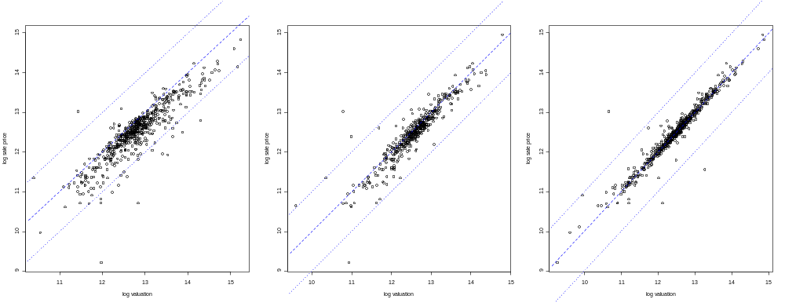
Valuation at origination
Valuation at kerbside
Valuation after possession

Slide 7
Volatility
Volatility of haircut (=sale price/valuation) appears to vary systematically:
Property type | SD(haircut)*
A | 11.6%
B | 9.3%
C | 31.2%
State/territory | SD(haircut)*
1 | NA
2 | 13.3%
3 | 7.7%
4 | 9.2%
5 | 15.6%
6 | 18.4%
7 | 14.8%
* valued after possession

Slide 8
Volatility modelling
Use regression to estimate haircut as a function of loan characteristics
Hierarchy of models, by complexity:
  Constant volatility
  Volatility varying by property type
  Volatility varying by property type and state
Use log-linear structure for volatility to ensure +ve variance estimates
Constant volatility model is ordinary linear regression
Varying-volatility models can be fit by generalised least squares, using gls in the nlme package
  Simpler and faster to directly maximise the Gaussian likelihood with optim/nlminb (latter will reproduce gls fit)

Slide 9
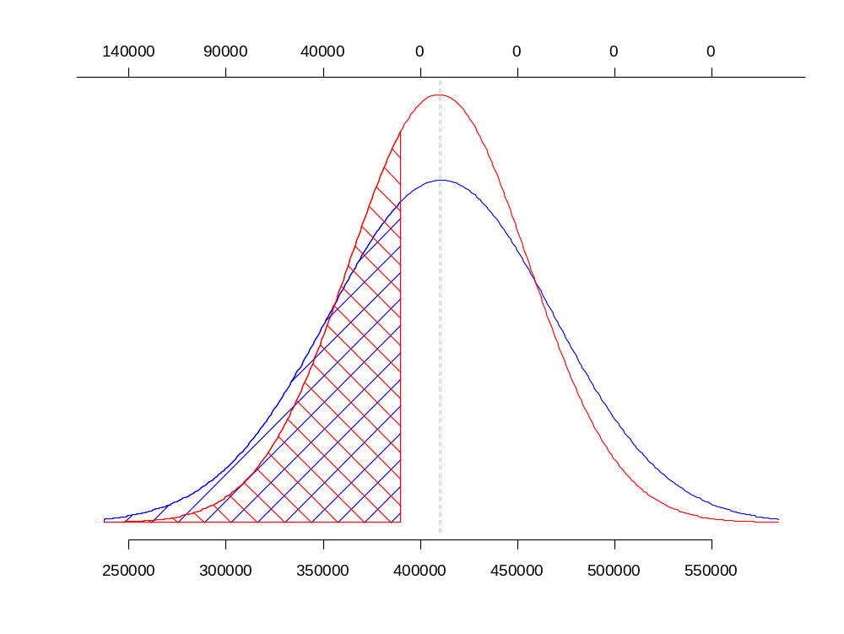
Shortfall
Estimated mean sale price fairly stable
Expected shortfall with volatility varying by property type
Expected shortfall under constant volatility
Sale price

Slide 10
Volatility: T-regression
Still assumes Gaussian distribution for volatility
Data can be more heavy-tailed than the Gaussian, even after deleting outliers
  Inflates estimates of variance
Solution: replace Gaussian distribution with t distribution on small df
  df acts as a shape parameter, controls how much influence outlying observations have
  Coding this is a straightforward extension of the Gaussian: simply change all *norm functions to *t
    Can still obtain Gaussian model by setting df=Inf
  cf Andrew Robinson’s previous MelbURN talk on robust regression and ML fitting

Slide 11
Example impact
Property type = C, state = 7, valuation $250k, EAD $240k
Gaussian model
Mean formula | Volatility formula | Expected shortfall ($)
~1 | ~1 | 7,610
~1 | ~proptype | 23,686
~1 | ~proptype + state | 29,931
t₅ model
Mean formula | Volatility formula | Expected shortfall ($)
~1 | ~1 | 4,493
~1 | ~proptype | 10,190
~1 | ~proptype + state | 5,896

Slide 12
Model fitting function (simplified)
tmod <- function(formula, formula.s, data, df, ...)
{
mf <- mf.s <- match.call(expand.dots = FALSE)
mf.s[["formula"]] <- mf.s$formula.s
mf$df <- mf$formula.s <- mf$... <- mf.s$df <- mf.s$formula.s <- mf.s$... <- NULL
mf[[1]] <- mf.s[[1]] <- as.name("model.frame")
mf <- eval(mf, parent.frame())
mf.s <- eval(mf.s, parent.frame())
mm <- model.matrix(attr(mf, "terms"), mf)
mm.s <- model.matrix(attr(mf.s, "terms"), mf.s)
y <- model.response(mf)
p <- ncol(mm)
p.s <- ncol(mm.s)
t.nll <- function(par, y, Xm, Xs)
{
m <- Xm %*% par[1:p]
logs <- Xs %*% par[-(1:p)]
-sum(dt((y - m)/exp(logs), df = df, log = TRUE) - logs)
}
lmf <- lm.fit(mm, y) # use ordinary least-squares fit as starting point
par <- c(lmf$coefficients, log(sd(lmf$residuals)), rep(0, p.s - 1))
names(par) <- c(colnames(mm), colnames(mm.s))
nlminb(par, t.nll, y = y, Xm = mm, Xs = mm.s, ...)
}
tmod(salepr/valuation ~ 1, ~ proptype + state, data = haircut, df = Inf)
tmod(salepr/valuation ~ proptype, ~ proptype, data = haircut, df = 5)

Slide 13
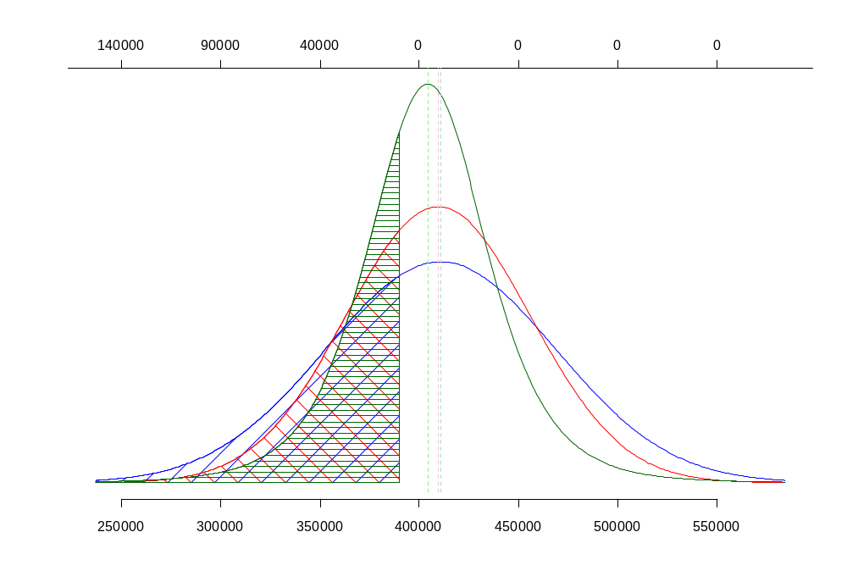
Shortfall
Because it downweights outliers, t distribution is more concentrated in the center
Expected shortfall with
t-distributed volatility
Sale price

Slide 14
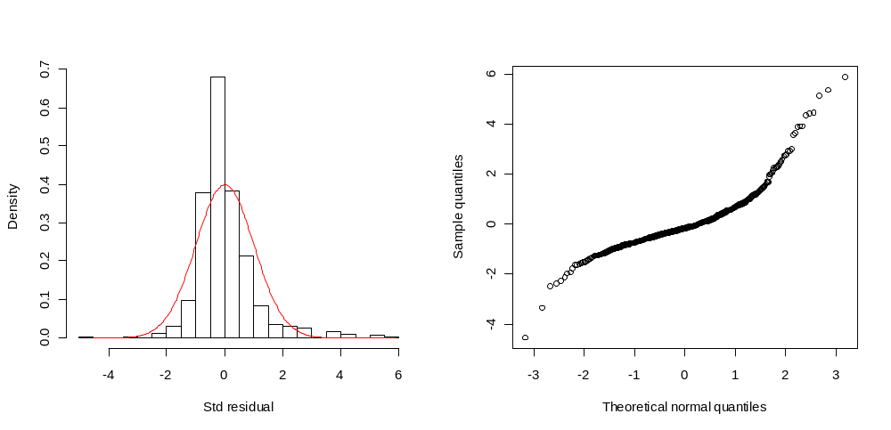
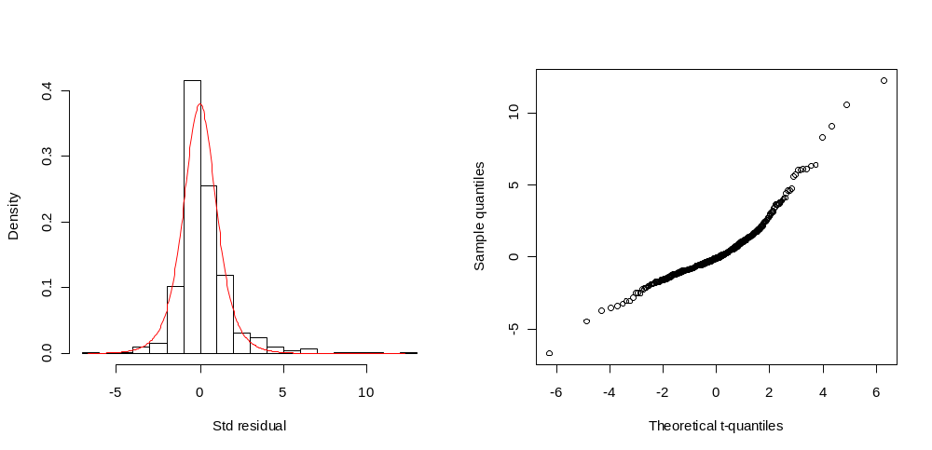
Normal model residuals
t₅-model residuals

Slide 15
Notes on model behaviour
Why does using a heavy-tailed error distribution reduce the expected shortfall?
  With normal distrib, volatility is overestimated
    → Likelihood of low sale price is also inflated
    t distrib corrects this
  Extreme tails of the t less important
    At lower end, sale price cannot go below 0
    At higher end, sale price > EAD is gravy
  This is not a monotonic relationship! At low enough thresholds, eventually heavier tail of the t will make itself felt
In most regression situations, assuming sufficient data, distributional assumptions (ie, normality, homoskedasticity) are not so critical: CLT comes into play
Here, they are important: changing the distributional assumptions can change expected shortfall by big amounts

Slide 16
In SAS
SAS has PROC MIXED for modelling variances, but only allows one grouping variable and assumes a normal distribution
PROC NLIN does general nonlinear optimisation
Also possible in PROC IML
None of these are as flexible or powerful as R
The R modelling function returns an object, which can be used to generate predictions, compute summaries, etc
SAS 9.2 now has PROC PLM that does something similar, but requires the modelling proc to execute a STORE statement first
  Only a few procs support this currently
  If you’re fitting a custom model (like this one), you’re out of luck

Slide 17
Through-the-cycle calibration
For capital purposes, we would like an estimate of default probability that doesn’t depend on the current state of the economy
This is called a through-the-cycle or long-run PD
  Contrast with a point-in-time or spot PD, which is what most models will give you (data is inherently point-in-time)
Exactly what long-run means can be the subject of philosophical debate; I’ll define it as a customer’s average risk, given their characteristics, across the different economic conditions that might arise
  This is not a lifetime estimate: eg their age/time on books doesn’t change
  Which variables are considered to be cyclical can be a tricky decision to make (many behavioural variables eg credit card balance are probably correlated with the economy)
  During bad economic times, the long-run PD will be below the spot, and vice-versa during good times
    You don’t want to have to raise capital during a crisis

Slide 18
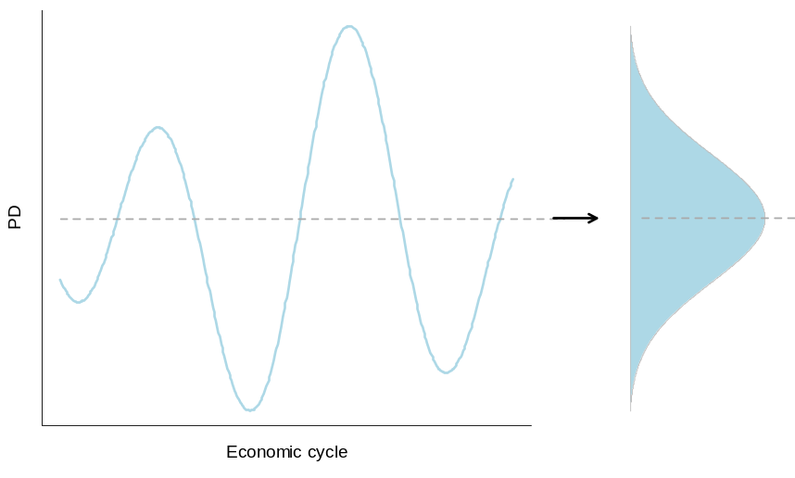
TTC approach
Start with the spot estimate:
PD(x, e) = f(x, e)
x = individual customer’s characteristics
e = economic variables (constant for all customers at any point in time)
Average over the possible values of e to get a TTC estimate

Slide 19
TTC approach
This is complicated numerically, can be done in various ways eg Monte Carlo
Use backcasting for simplicity: take historical values of e, substitute into prediction equation, average the results
  As we are interested in means rather than quantiles, this shouldn’t affect accuracy much (other practical issues will have much more impact)
R used to handle backcasting, combining multiple spot PDs into one output value

Slide 20
TTC calculation
Input from spot model is a prediction equation, along with sample of historical economic data
spot_predict <- function(data)
{
# code copied from SAS; with preprocessing, can be arbitrarily complex
xb <- with(data, b0 + x1 * b1 + x2 * b2 + ... )
plogis(xb)
}
ttc_predict <- function(data, ecodata, from = "2000-01-01", to = "2010-12-01")
{
dates <- seq(as.Date(from), as.Date(to), by = "months")
evars <- names(ecodata)
pd <- matrix(nrow(data), length(dates))
for(i in seq_along(dates))
{
data[evars] <- subset(ecodata, date == dates[i], evars)
pd[, i] <- spot_predict(data)
}
apply(pd, 1, mean)
}

Slide 21
Binning/cohorting
Raw TTC estimate is a combination of many spot PDs, each of which is from a logistic regression
→ TTC estimate is a complicated function of customer attributes
Need to simplify for communication, implementation purposes
Turn into bins or cohorts based on customer attributes: estimate for each cohort is the average for customers within the cohort
Take pragmatic approach to defining cohorts
  Create tiers based on small selection of variables that will split out riskiest customers
  Within each tier, create contingency table using attributes deemed most interesting/important to the business
  Number of cohorts limited by need for simplicity/manageability, <1000 desirable
  Not a data-driven approach, although selection of variables informed by data exploration/analysis

Slide 22
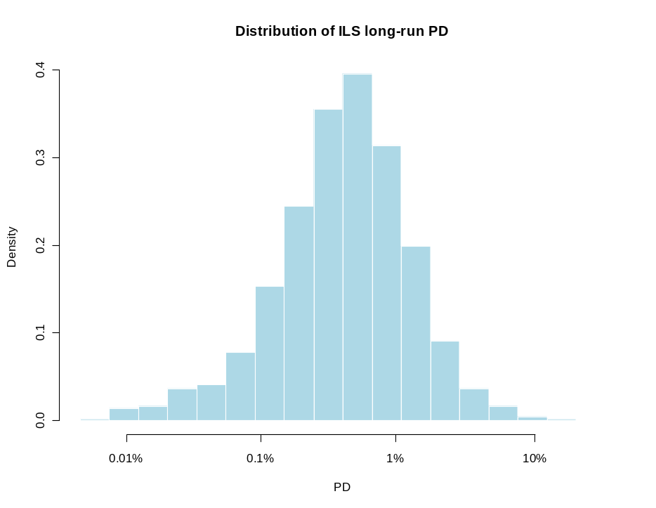
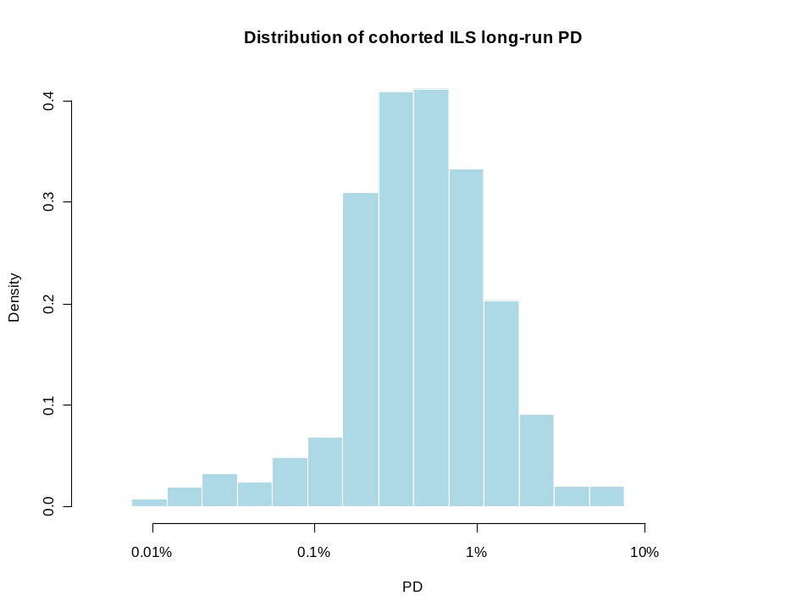
Binning/cohorting
Example from nameless portfolio:
Raw TTC PD
Cohorted TTC PD

Slide 23
Binning input
varlist <- list(
low_doc2=list(name="low_doc",
breaks=c("N", "Y"),
midp=c("N", "Y"),
na.val="N"),
enq =list(name="wrst_nbr_enq",
breaks=c(-Inf, 0, 5, 15, Inf),
midp=c(0, 3, 10, 25),
na.val=0),
lvr =list(name="new_lvr_basel",
breaks=c(-Inf, 60, 70, 80, 90, Inf),
midp=c(50, 60, 70, 80, 95),
na.val=70),
...
low_doc wrst_nbr_enq new_lvr_basel ... tier1 tier2
1 N 0 50 ... 1 1
2 N 0 60 ... 1 2
3 N 0 70 ... 1 3
4 N 0 80 ... 1 4
5 N 0 95 ... 1 5
6 N 3 50 ... 1 6
7 N 3 60 ... 1 7
8 N 3 70 ... 1 8
9 N 3 80 ... 1 9
10 N 3 95 ... 1 10
by application of expand.grid()...

Slide 24
Binning output
if low_doc = ' ' then low_doc2 = 1;
else if low_doc = 'Y' then low_doc2 = 1;
else low_doc2 = 2;
if wrst_nbr_enq = . then enq = 0;
else if wrst_nbr_enq <= 0 then enq = 0;
else if wrst_nbr_enq <= 5 then enq = 3;
else if wrst_nbr_enq <= 15 then enq = 10;
else enq = 25;
if new_lvr_basel = . then lvr = 70;
else if new_lvr_basel <= 60 then lvr = 50;
else if new_lvr_basel <= 70 then lvr = 60;
else if new_lvr_basel <= 80 then lvr = 70;
else if new_lvr_basel <= 90 then lvr = 80;
else lvr = 95;
...
if lvr = 50 and enq = 0 and low_doc = 'N' then do; tier2 = 1; ttc_pd = ________; end;
else if lvr = 60 and enq = 0 and low_doc = 'N' then do; tier2 = 2; ttc_pd = ________; end;
else if lvr = 70 and enq = 0 and low_doc = 'N' then do; tier2 = 3; ttc_pd = ________; end;
else if lvr = 80 and enq = 0 and low_doc = 'N' then do; tier2 = 4; ttc_pd = ________; end;
else if lvr = 95 and enq = 0 and low_doc = 'N' then do; tier2 = 5; ttc_pd = ________; end;
else if lvr = 50 and enq = 3 and low_doc = 'N' then do; tier2 = 6; ttc_pd = ________; end;
else if lvr = 60 and enq = 3 and low_doc = 'N' then do; tier2 = 7; ttc_pd = ________; end;
...

Slide 25
Binning/cohorting
R code to generate SAS code for scoring a dataset:
sas_all <- character()
for(i in seq_along(tierdefs))
{
tvars <- tierdefs[[i]]
varnames <- lapply(varlist[tvars], `[[`, "name")
this_tier <- which(celltable$tier == i)
sas <- "if"
for(j in seq_along(tvars))
{
sas <- paste(sas, tvars[j], "=", as.numeric(celltable[this_tier, varnames[j]]))
if(j < length(tvars))
sas <- paste(sas, "and")
}
sas <- paste(sas, sprintf("then do; tier2 = %d; ttc_pd = %s;", celltable$tier2[this_tier],
celltable$ttc_pd[this_tier]))
sas[-1] <- paste("else", sas[-1])
sas_all <- c(sas_all, sas,
sprintf("else put 'ERROR: unhandled case, tier = %d n = ' _n_;", i))
}
writeLines(sas_all, sasfile)

Slide 26
Stress testing simulation
Banks run stress tests on their loan portfolios, to see what a downturn would do to their financial health
Mathematical framework is similar to the “Vasicek model”:
  Represent the economy by a parameter X
  Each loan has a transition matrix that is shifted based on X, determining its risk grade in year t given its grade in year t - 1
    Defaults if bottom grade reached
Take a scenario/simulation-based approach: set X to a stressed value, run N times, take the average
  Contrast to VaR: “average result for a stressed economy”, as opposed to “stressed result for an average economy”
Example data: portfolio of 100,000 commercial loans along with current risk grade, split by subportfolio
Simulation horizon: ~3 years

Slide 27
Application outline
Front end in Excel (because the business world lives in Excel)
  Calls SAS to setup datasets
    Calls R to do the actual computations
Previous version was an ad-hoc script written entirely in SAS, took ~4 hours to run, often crashed due to lack of disk space
  Series of DATA steps (disk-bound)
  Transition matrices represented by unrolled if-then-else statements (25x25 matrix becomes 625 lines of code)
Reduced to 2 minutes with R, 1 megabyte of code cut to 10k
  No rocket science involved: simply due to using a better tool
  Similar times achievable with PROC IML, of which more later

Slide 28
Application outline
For each subportfolio and year, get the median result and store it
Next year’s simulation uses this year’s median portfolio
To avoid having to store multiple transited copies of the portfolio, we manipulate random seeds
for(p in 1:nPortfolios) # varies by project
{
for(y in 1:nYears) # usually 2-5
{
seed <- .GlobalEnv$.Random.seed
for(i in 1:nIters) # around 1,000, but could be less
result[i] = summary(doTransit(portfolio[p, y], T[p, y]))
med = which(result == median(result))
portfolio[p, y + 1] = doTransit(portfolio[p, y], T[p, y], seed, med)
}
}

Slide 29
Data structures
For business reasons, we want to split the simulation by subportfolio
And also present results for each year separately
  → Naturally have 2-dimensional (matrix) structure for output: [i, j]th entry is the result for the ith subportfolio, jth year
But desired output for each [i, j] might be a bunch of summary statistics, diagnostics, etc
  → Output needs to be a list
Similarly, we have a separate input transition matrix for each subportfolio and year
  → Input should be a matrix of matrices

Slide 30
Data structures
R allows matrices whose elements are lists:
T <- matrix(list(), nPortfolios, nYears)
for(i in 1:nPortfolios) for(j in 1:nYears)
T[[i, j]] <- getMatrix(i, j, ...)
M <- matrix(list(), nPortfolios, nYears)
M[[i, j]]$result <- doTransit(i, j, ...)
M[[i, j]]$sumstat <- summary(M[[i, j]]$result)

Slide 31
Data structures
Better than the alternatives:
  List of lists: L[[i]][[j]] contains data that would be in M[[i, j]]
    Lose ability to operate on/extract all values for a given i or j via matrix indexing
  Separate matrices for each statistic of interest (ie, doing it Fortran-style)
    Many more variables to manage, coding becomes a chore
    No structure, so loops may involve munging of variable names
  Multidimensional arrays conflate data and metadata
But can lead to rather cryptic code:
  getComponent <- function(x, component)
  {
  x[] <- lapply(x, `[[`, component)
  lapply(apply(x, 1, I), function(xi) do.call("rbind", xi))
  }
  getComponent(M, "sumstat")

Slide 32
PROC IML: a gateway to R
As of SAS 9.2, you can use IML to execute R code, and transfer datasets to and from R:
  PROC IML;
  call ExportDataSetToR('portfol', 'portfol'); /* creates a data frame */
  call ExportMatrixToR("&Rfuncs", 'rfuncs');
  call ExportMatrixToR("&Rscript", 'rscript');
  call ExportMatrixToR("&nIters", 'nIters');
  ...
  submit /R;
  source(rfuncs)
  source(rscript)
  endsubmit;
  call ImportDataSetFromR('result', 'result');
  QUIT;
No messing around with import/export via CSV, transport files, etc
Half the code in an earlier version was for import/export

Slide 33
IML: a side-rant
IML lacks:
  Logical vectors: everything has to be numeric or character
  Support for zero-length vectors (you don’t realise how useful they are until they’re gone)
  Unoriented vectors: everything is either a row or column vector (technically, everything is a matrix)
So something like x = x + y[z < 0]; fails in three ways
IML also lacks anything like a dataset/data frame: everything is a matrix
  → It’s easier to transfer a SAS dataset to and from R, than IML
Everything is a matrix: no lists, let alone lists of lists, or matrices of lists
  Not even multi-way arrays
Which puts the occasional online grouching about R into perspective

Slide 34
Other SAS/R interfaces
SAS has a proprietary dataset format (or, many proprietary dataset formats)
  R’s foreign package includes read.ssd and read.xport for importing, and write.foreign(*, package="SAS") for exporting
  Package Hmisc has sas.get
  Package sas7bdat has an experimental reader for this format
  Revolution R can read SAS datasets
  All have glitches, are not widely available, or not fully functional
    First 2 also need SAS installed
SAS 9.2 and IML make these issues moot
  You just have to pay for it
  Caveat: only works with R <= 2.11.1 (2.12 changed the locations of binaries)
    SAS 9.3 will support R 2.12+

Slide 35
R and SAS rundown
Advantages of R
  Free! (base distribution, anyway)
  Very powerful statistical programming environment: SAS takes 3 languages to do what R does with 1
  Flexible and extensible
  Lots of features (if you can find them)
    User-contributed packages are a blessing and a curse
  Ability to handle large datasets is improving
Advantages of SAS
  Pervasive presence in large firms
    “Nobody got fired for buying IBM SAS”
    Compatibility with existing processes/metadata
    Long-term support
  Tremendous data processing/data warehousing capability
  Lots of features (if you can afford them)
  Sometimes cleaner than R, especially for data manipulation

Slide 36
R and SAS rundown
Example: get weighted summary statistics by groups
  proc summary data = indat nway;
  class a b;
  var x y;
  weight w;
  output sum(w)=sumwt mean(x)=xmean mean(y)=ymean var(y)=yvar
  out = outdat;
  run;
  outdat <- local({
  res <- t(sapply(split(indat, indat[c("a", "b")]), function(subset) {
  c(xmean = weighted.mean(subset$x, subset$w),
  ymean = weighted.mean(subset$y, subset$w),
  yvar = cov.wt(subset["y"], subset$w)$cov)
  }))
  levs <- aggregate(w ~ a + b, data=indat, sum)
  cbind(levs, as.data.frame(res))
  })
Thank god for plyr

Slide 37
Challenges for deploying R
Quality assurance, or perception thereof
  Core is excellent, but much of R’s attraction is in extensibility, ie contributed packages
  Can I be sure that the package I just downloaded does what it says? Is it doing more than it says?
  Backward compatibility
    Telling people to use the latest version is not always helpful
No single point of contact
  Who do I yell at if things go wrong?
  How can I be sure everyone is using the same version?
Unix roots make package development clunky on Windows
  Process is more fragile because it assumes Unix conventions
  Why must I download a set of third-party tools to compile code?
  Difficult to integrate with Visual C++/Visual Studio
Interfacing with languages other than Fortran, C, C++ not yet integrated into core

Slide 38
Commercial R: an aside
Many of these issues are fundamental in nature
Third parties like Revolution Analytics can address them, without having to dilute R’s focus (I am not a Revo R user)
  Other R commercialisations existed but seem to have disappeared
  Anyone remember S-Plus?
  Challenge is not to negate R’s drawcards
    Low cost: important even for big companies
    Community and ecosystem
      Can I use Revo R with that package I got from CRAN?
      If I use Revo R, can I/should I participate on R-Help, StackOverflow.com?
Also why SAS, SPSS, etc can include interfaces to R without risking too much

Slide 39
Good problems to have
Sign of R’s movement into the mainstream
S-Plus now touts R compatibility, rather than R touting S compatibility
Nobody cares that SHAZAM, GLIM, XLisp-Stat etc don’t support XML, C# or Java

Slide 40
Other resources
SAS and R blog by Ken Kleinman and Nick Horton
  Online support for their book, SAS and R: Data Management, Statistical Analysis, and Graphics
Hadley Wickham’s site
  STAT480 covers Excel, R and SAS (the links to UCLA ATS files are broken, use /stat/ instead of /STAT/)
The DO Loop is the official SAS/IML blog
inside-R, the Revolution Analytics community site
R-bloggers: aggregated blogroll for R
AnnMaria De Mars’ blog on SAS and social science (contains pictures of naked mole rats)

